Slide 1


Difference between
Resume, CV and Biodata
Subject: Professional Communication
Branch: - IT (3rd Sem)
Presentation By:
Adnan Khan

Slide 2

Introduction of Presentation
This presentation explains the differences between three key documents used in both professional and academic settings: Resume, CV, and Biodata. Each of these documents highlights your skills and qualifications in unique ways and is used for different purposes.

Slide 3

Index
  What is Resume?
  What is CV?
  What is Biodata?
  Key differences between them
  Relevance of each Document
  Tips for effective Resume, CV or Biodata
  Conclusion

Slide 4
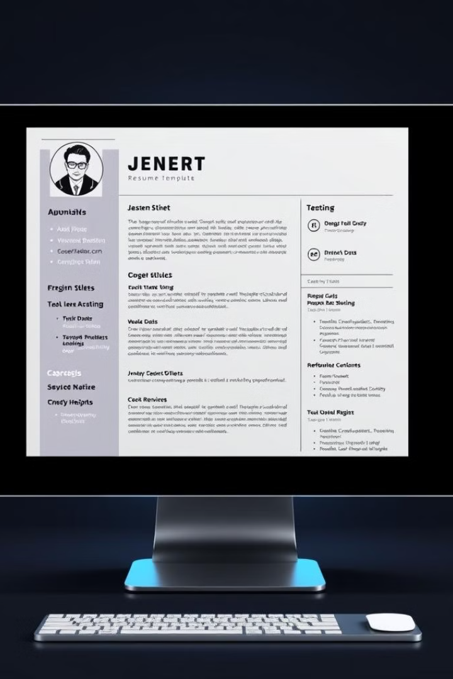
What is a Resume?
A resume is a formal document that provides a concise summary of an individual's education, work experience, skills and achievements The purpose of a resume is to showcase your suitability for a specific role and to convince a recruiter to invite you for an interview.
1
Tailored
2
Concise
Resumes are customized for each job you apply to.
A resume is typically one page long.
3
Action-Oriented
4
Professional
It highlights the accomplishments and skills that are important for the job.
Resumes show information in a simple and organized way.

Slide 5

What is a
Curriculum Vitae (CV)?
A CV (Curriculum Vitae) is a detailed document that outlines your academic and professional achievements, work experience, skills, and other qualifications. It is typically longer than a resume and provides a more comprehensive overview of your career.
1
Length
2
Focus
CVs are typically longer than resumes.
CVs focus on research achievements like Publications, Research Projects, etc.
3
Content
CVs include a complete academic history, publications, presentations, and research experience.

Slide 6

What is a Biodata?
A biodata is a detailed personal profile. It provides comprehensive information about your personal and professional background, including education, employment, family, and contact details.
1
Purpose
2
Focus
Matrimonial Purposes, Informal Applications
Personal and Professional Background
3
Content
Comprehensive Personal Information

Slide 7
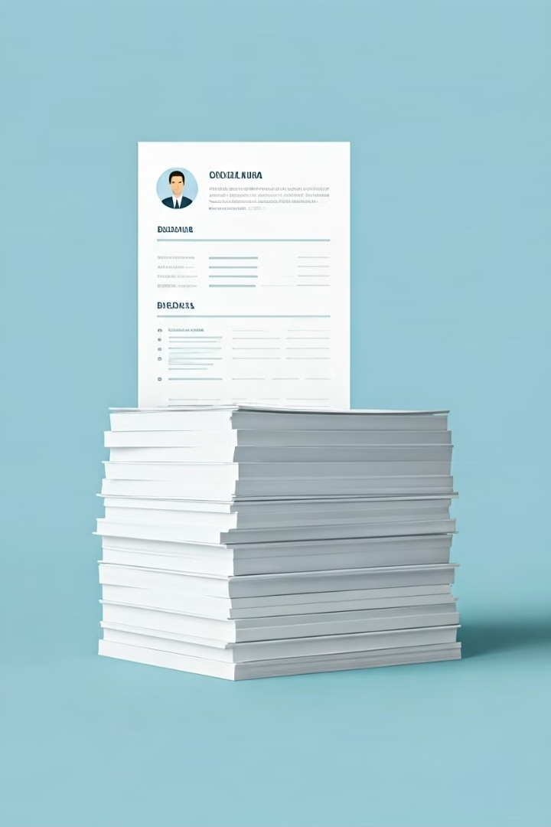
Key Differences:
Length and Content
Document
Length
Content
Resume
1-2 pages
Job-specific experience and skills
CV
2-5 pages
Detailed academic and professional history
Biodata
Multiple pages
Extensive personal and professional information

Slide 8
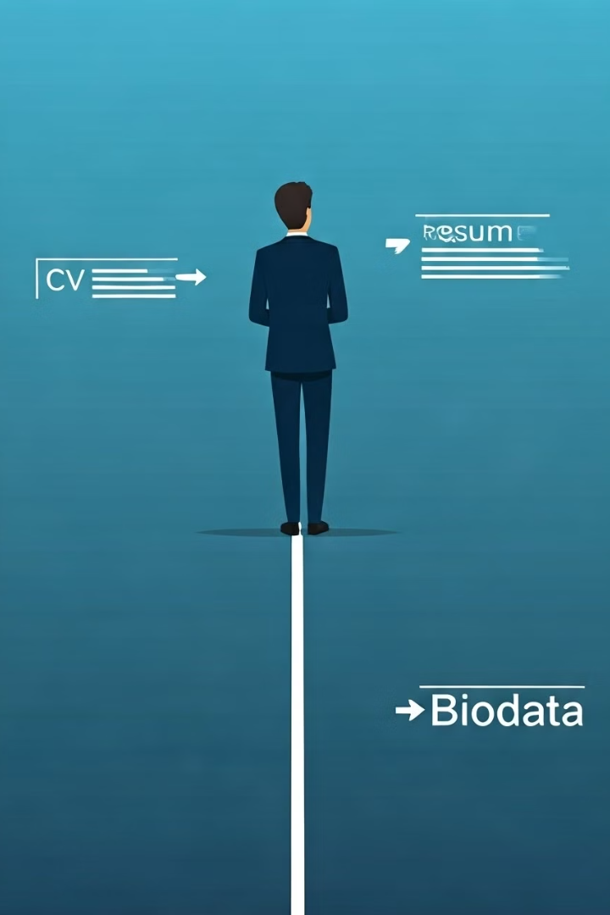
Relevance of Each Document
1
Resume
Essential for applying to jobs, internships, and other professional opportunities.
2
CV
Crucial for academic positions, research fellowships, and grants.
3
Biodata
Used for various applications, including Matrimonial Purposes, immigration, and personal introductions.

Slide 9
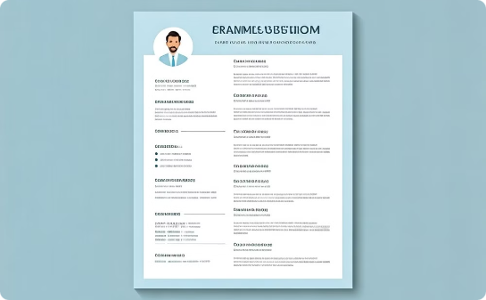

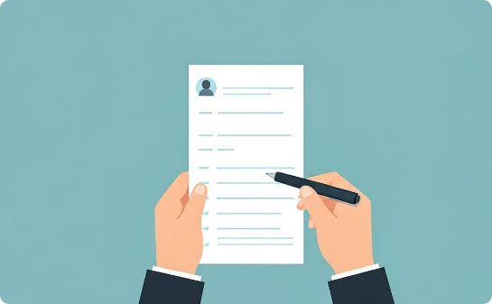
Tips for Effective Resume, CV, and Biodata
Organization
Highlight Achievements
Proofreading
Clear structure, concise language, and proper formatting for easy readability.
Quantify your achievements, showcase your skills and contributions.
Ensure accuracy and free from errors in grammar, spelling, and formatting.

Slide 10

Conclusion
Knowing the differences between Resume, CV, and Biodata is essential for navigating professional and academic paths. Use the right document for the right purpose and tailor your content to effectively showcase your qualifications.

Slide 11

Thank You for Your Attention & Presence

